Slide 1
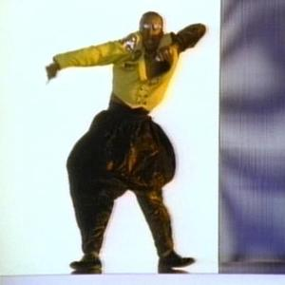
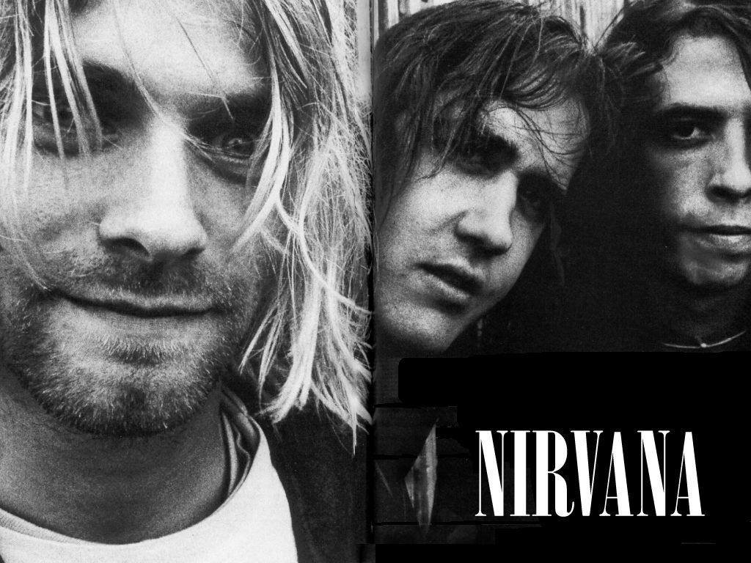
1990’s

Slide 2
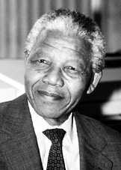
1990
China lifts martial law
Hubble telescope launched into space
Iraq invades Kuwait, leading to the Gulf War
South Africa frees Nelson Mandela after 27.5 years of imprisonment

Slide 3
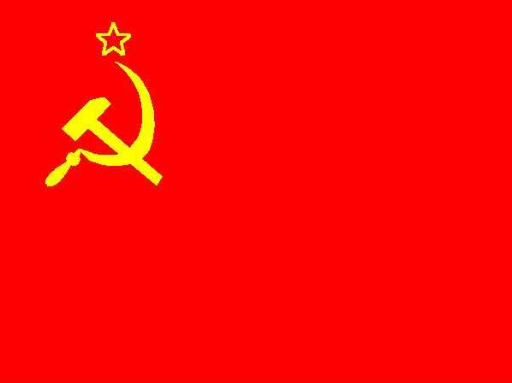
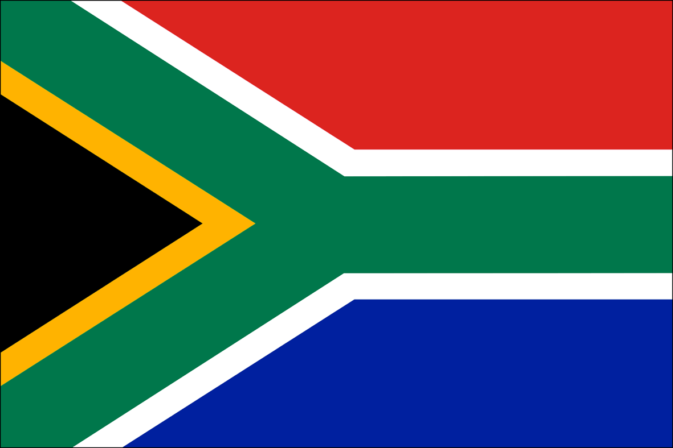
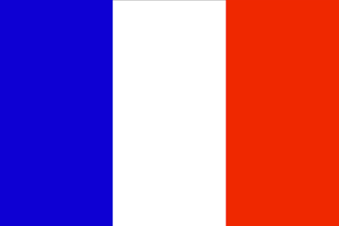
1991
Cold war ends as USSR dissolves
South Africa appeals apartheid laws
Major health scandal in France, over 12,000 people were infected with HIV from tainted blood

Slide 4
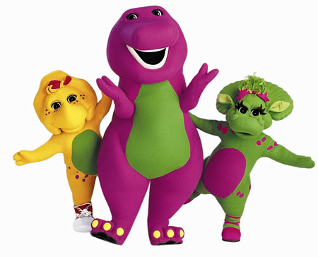
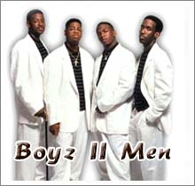
1992
“End of the Road” Boyz II Men
“Barney and Friends”
Bill Clinton elected president of US
Riots in Los Angeles After the Rodney King Verdict

Slide 5
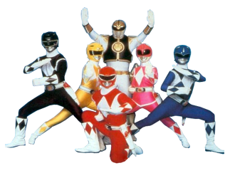
1993
World Trade Center Bombed
World Wide Web becomes Public
Power Rangers Begins

Slide 6
1994
Rwandan President Juvenal Habayarimana and Burundi President Cyprien Ntayamira are killed by missiles. This was a precursor to the Rwandan Genocide
Nelson Mandela is elected President of South Africa

Slide 7
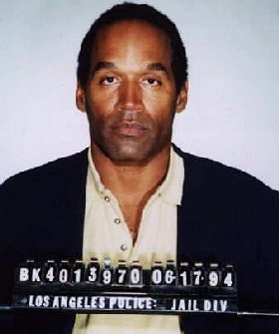
1995
OJ Simpson is found not guilty of Nicole Brown Simpson and Ronald Goldman
President Bill Clinton extends a 20 billion dollar loan to Mexico to avert financial collapse.

Slide 8
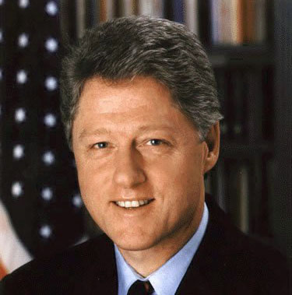
1996:
The first Pokémon game and the Nintendo 64 were both released in Japan.
Democratic incumbent Bill Clinton defeated Republican Bob Dole to win his second term in office.
1997:
Chess computer "Deep Blue" defeats world chess champion Garry Kasparov for the first time.
Notes:
1996: Pokemon Green was released in Japan as the first in the world famous Pokemon series, also in Japan the Nintendo 64 game system was released later in the year.
November 5th 1996 : Democratic incumbent Bill Clinton defeated Republican Bob Dole to win his second term in office.
May 11 1997 : Chess computer "Deep Blue" defeats world chess champion Garry Kasparov 2 matches to 1.

Slide 9
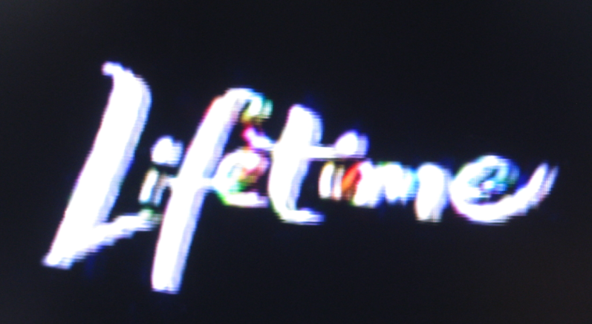
1998
Osama Bin Laden bombed US embassies in Nairobi, Kenya, Dar es Saleem leading to 224 deaths.
Google was invented by Larry Page and Sergery Brin In California
Lifetime movie network was launched

Slide 10
1999
The Euro was established
Napster debuted
Both Britney Spears and Christina Aguilera launched their premiere CD’s, establishing a new wave of female pop music.

